Slide 1



bp India Student Challenge 2025-26
Reservoir Revivers
Where Insight Revives Energy

Slide 2
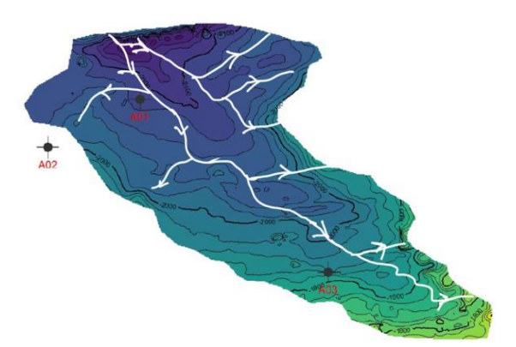
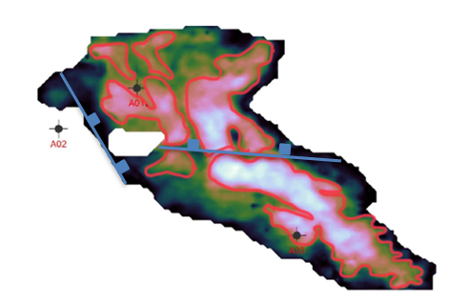
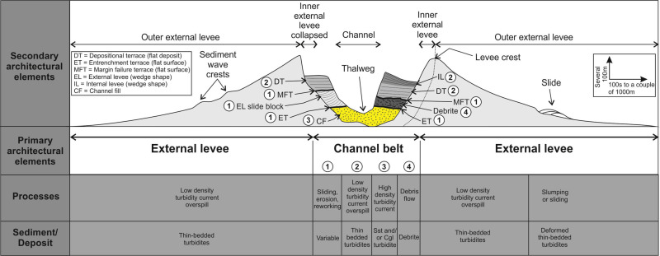
Dominant Channel Fairway
WELLS | SAND THICKNESS (Calculated from channel thickness) | WELL LOG THICKNESS | REASON
A01 | 99 m (Approx) | 99.47 m | A1 sand thickness and well log thickness corroborate, because the contours are widely spaced and hence the dip in that region is almost horizontal thus the true sand thickness is same as the vertical thickness of the sand calculated via well log.
A02 | Cannot calculate (Data Not Available) | 95.1 m | A2 is outside the map area hence cannot be concluded
A03 | 70 m (Approx) | 59.87 m | A3 sand thickness and well log thickness do not corroborate, because the contours are closely spaced and hence the dip in that region is high thus the true sand thickness is not same as the vertical thickness of the sand calculated via well log.
Thickness (Isopach) - NW is 100-135 m thick, SE is 20-30 m. Sediment physically cannot travel uphill to preferentially deposit at its source. Thick = proximal mouth (NW), thin = distal fringe (SE).
Valley Rule - Tributary branches join the main trunk downslope. All confluences on the white fairway map are consistent only with NW-high → SE-low geometry. Tributaries cannot climb to meet the trunk.
this area the channel spreads out in
Combined Trap Type - Channel levees form the stratigraphic traps along the margins
The possibility of growth faults have been asserted on the bases of changes in elevation of turbidite SNA values, sharp turning of contours and well-log correlation
Figure: Conceptual model of deep-water channel-levee depositional architecture

Slide 3
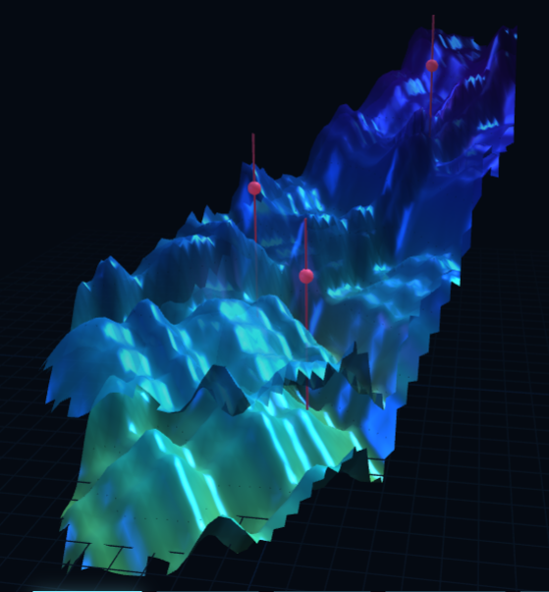
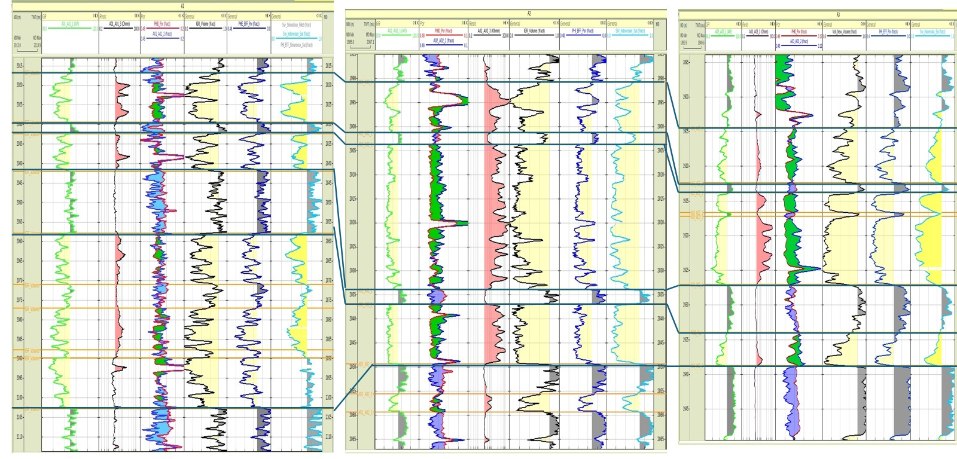
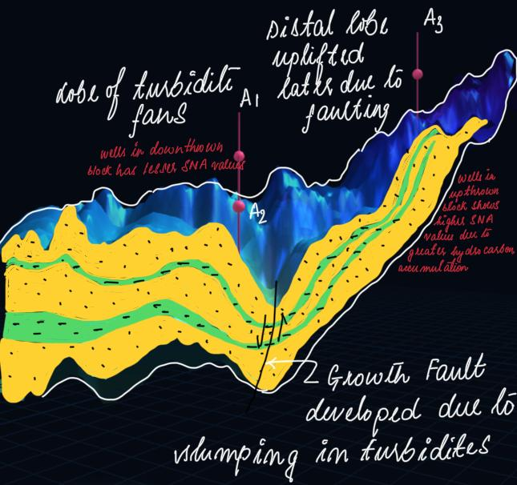
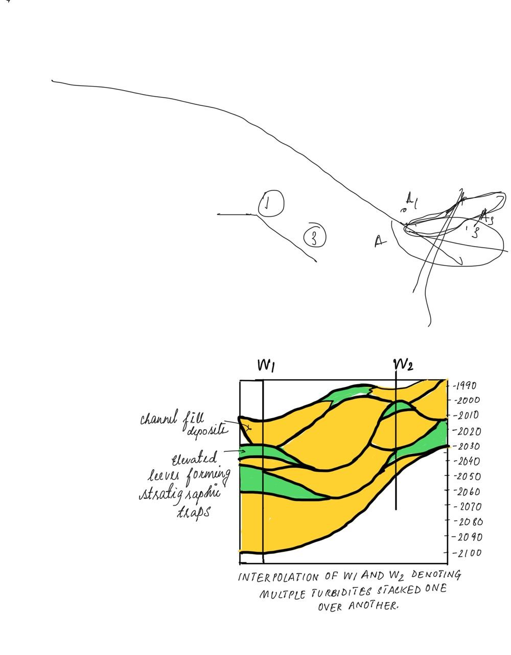
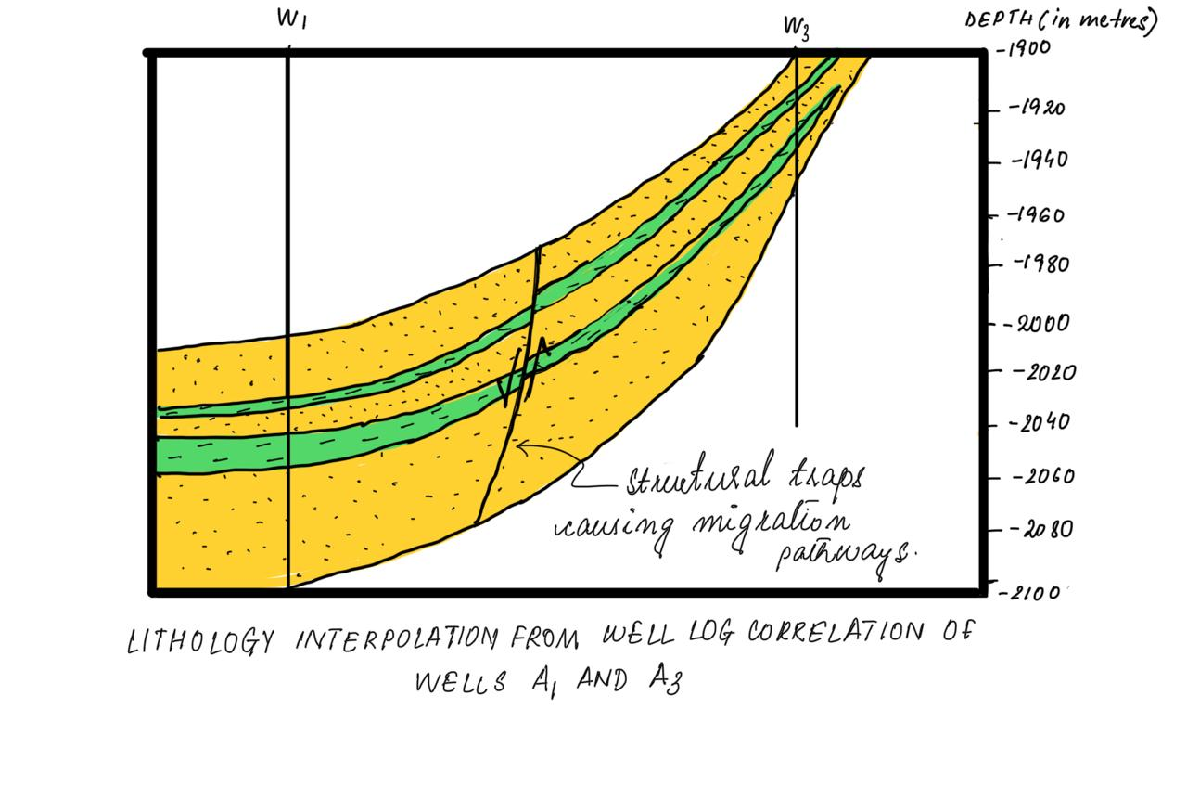
Modelling and Well Log Correlation
Well A01
Well A02
Well A03

Slide 4
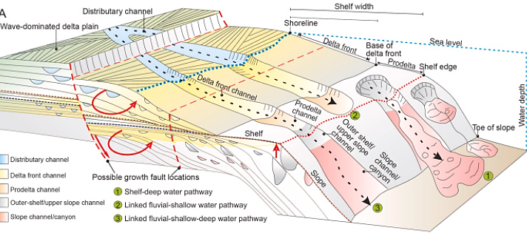
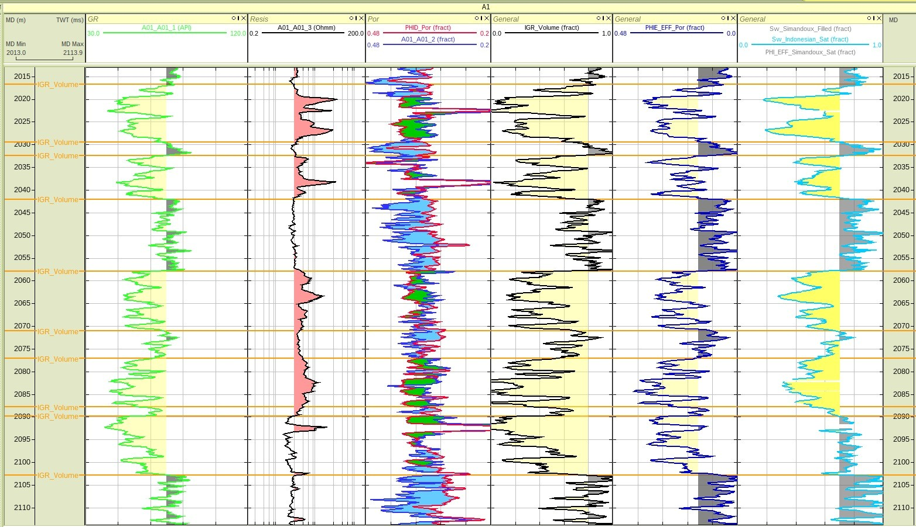
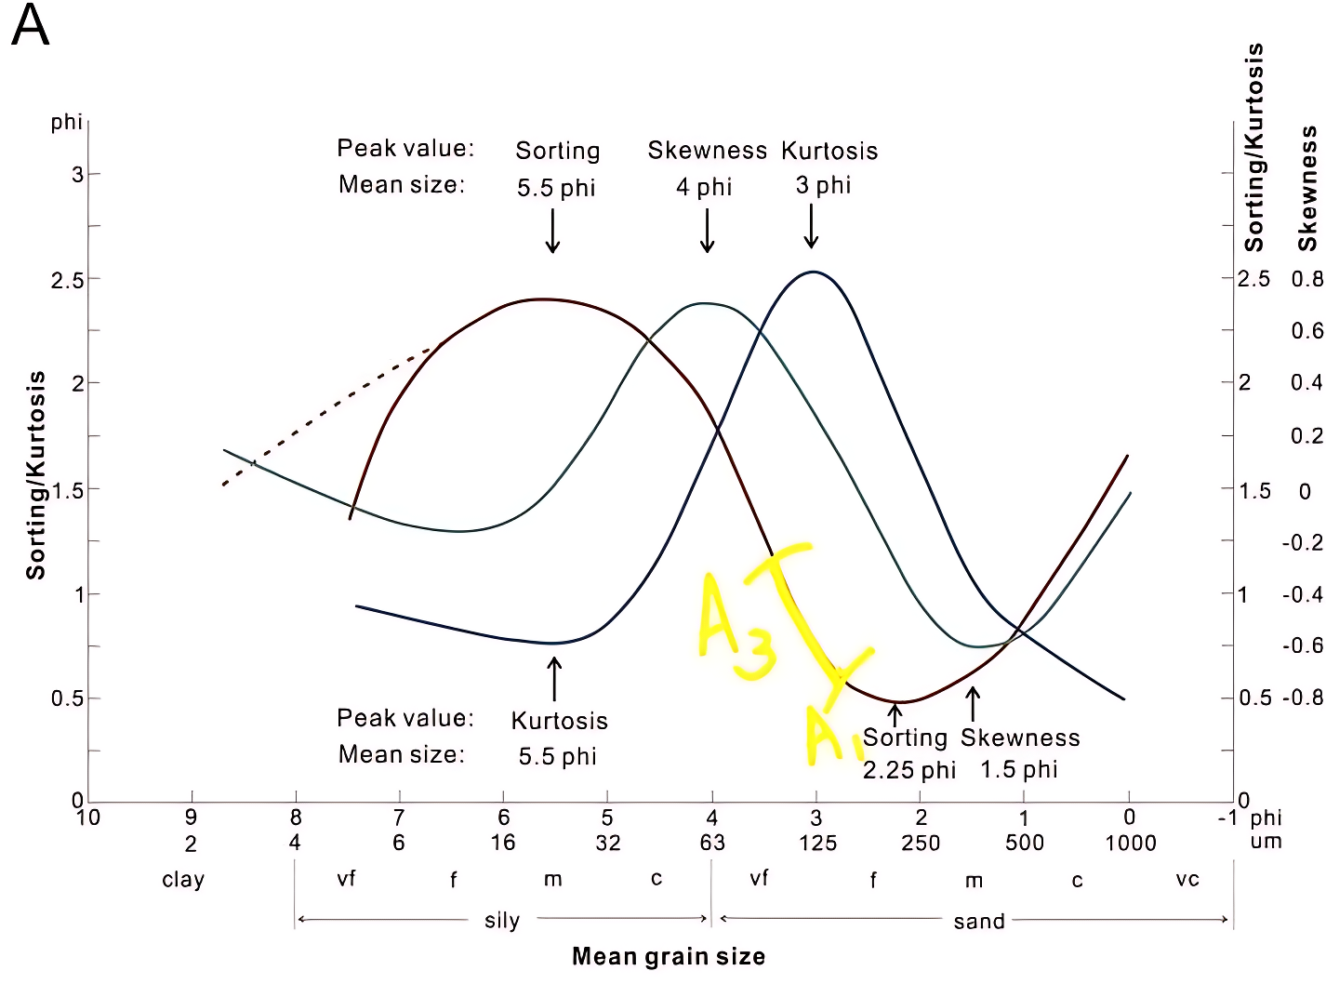
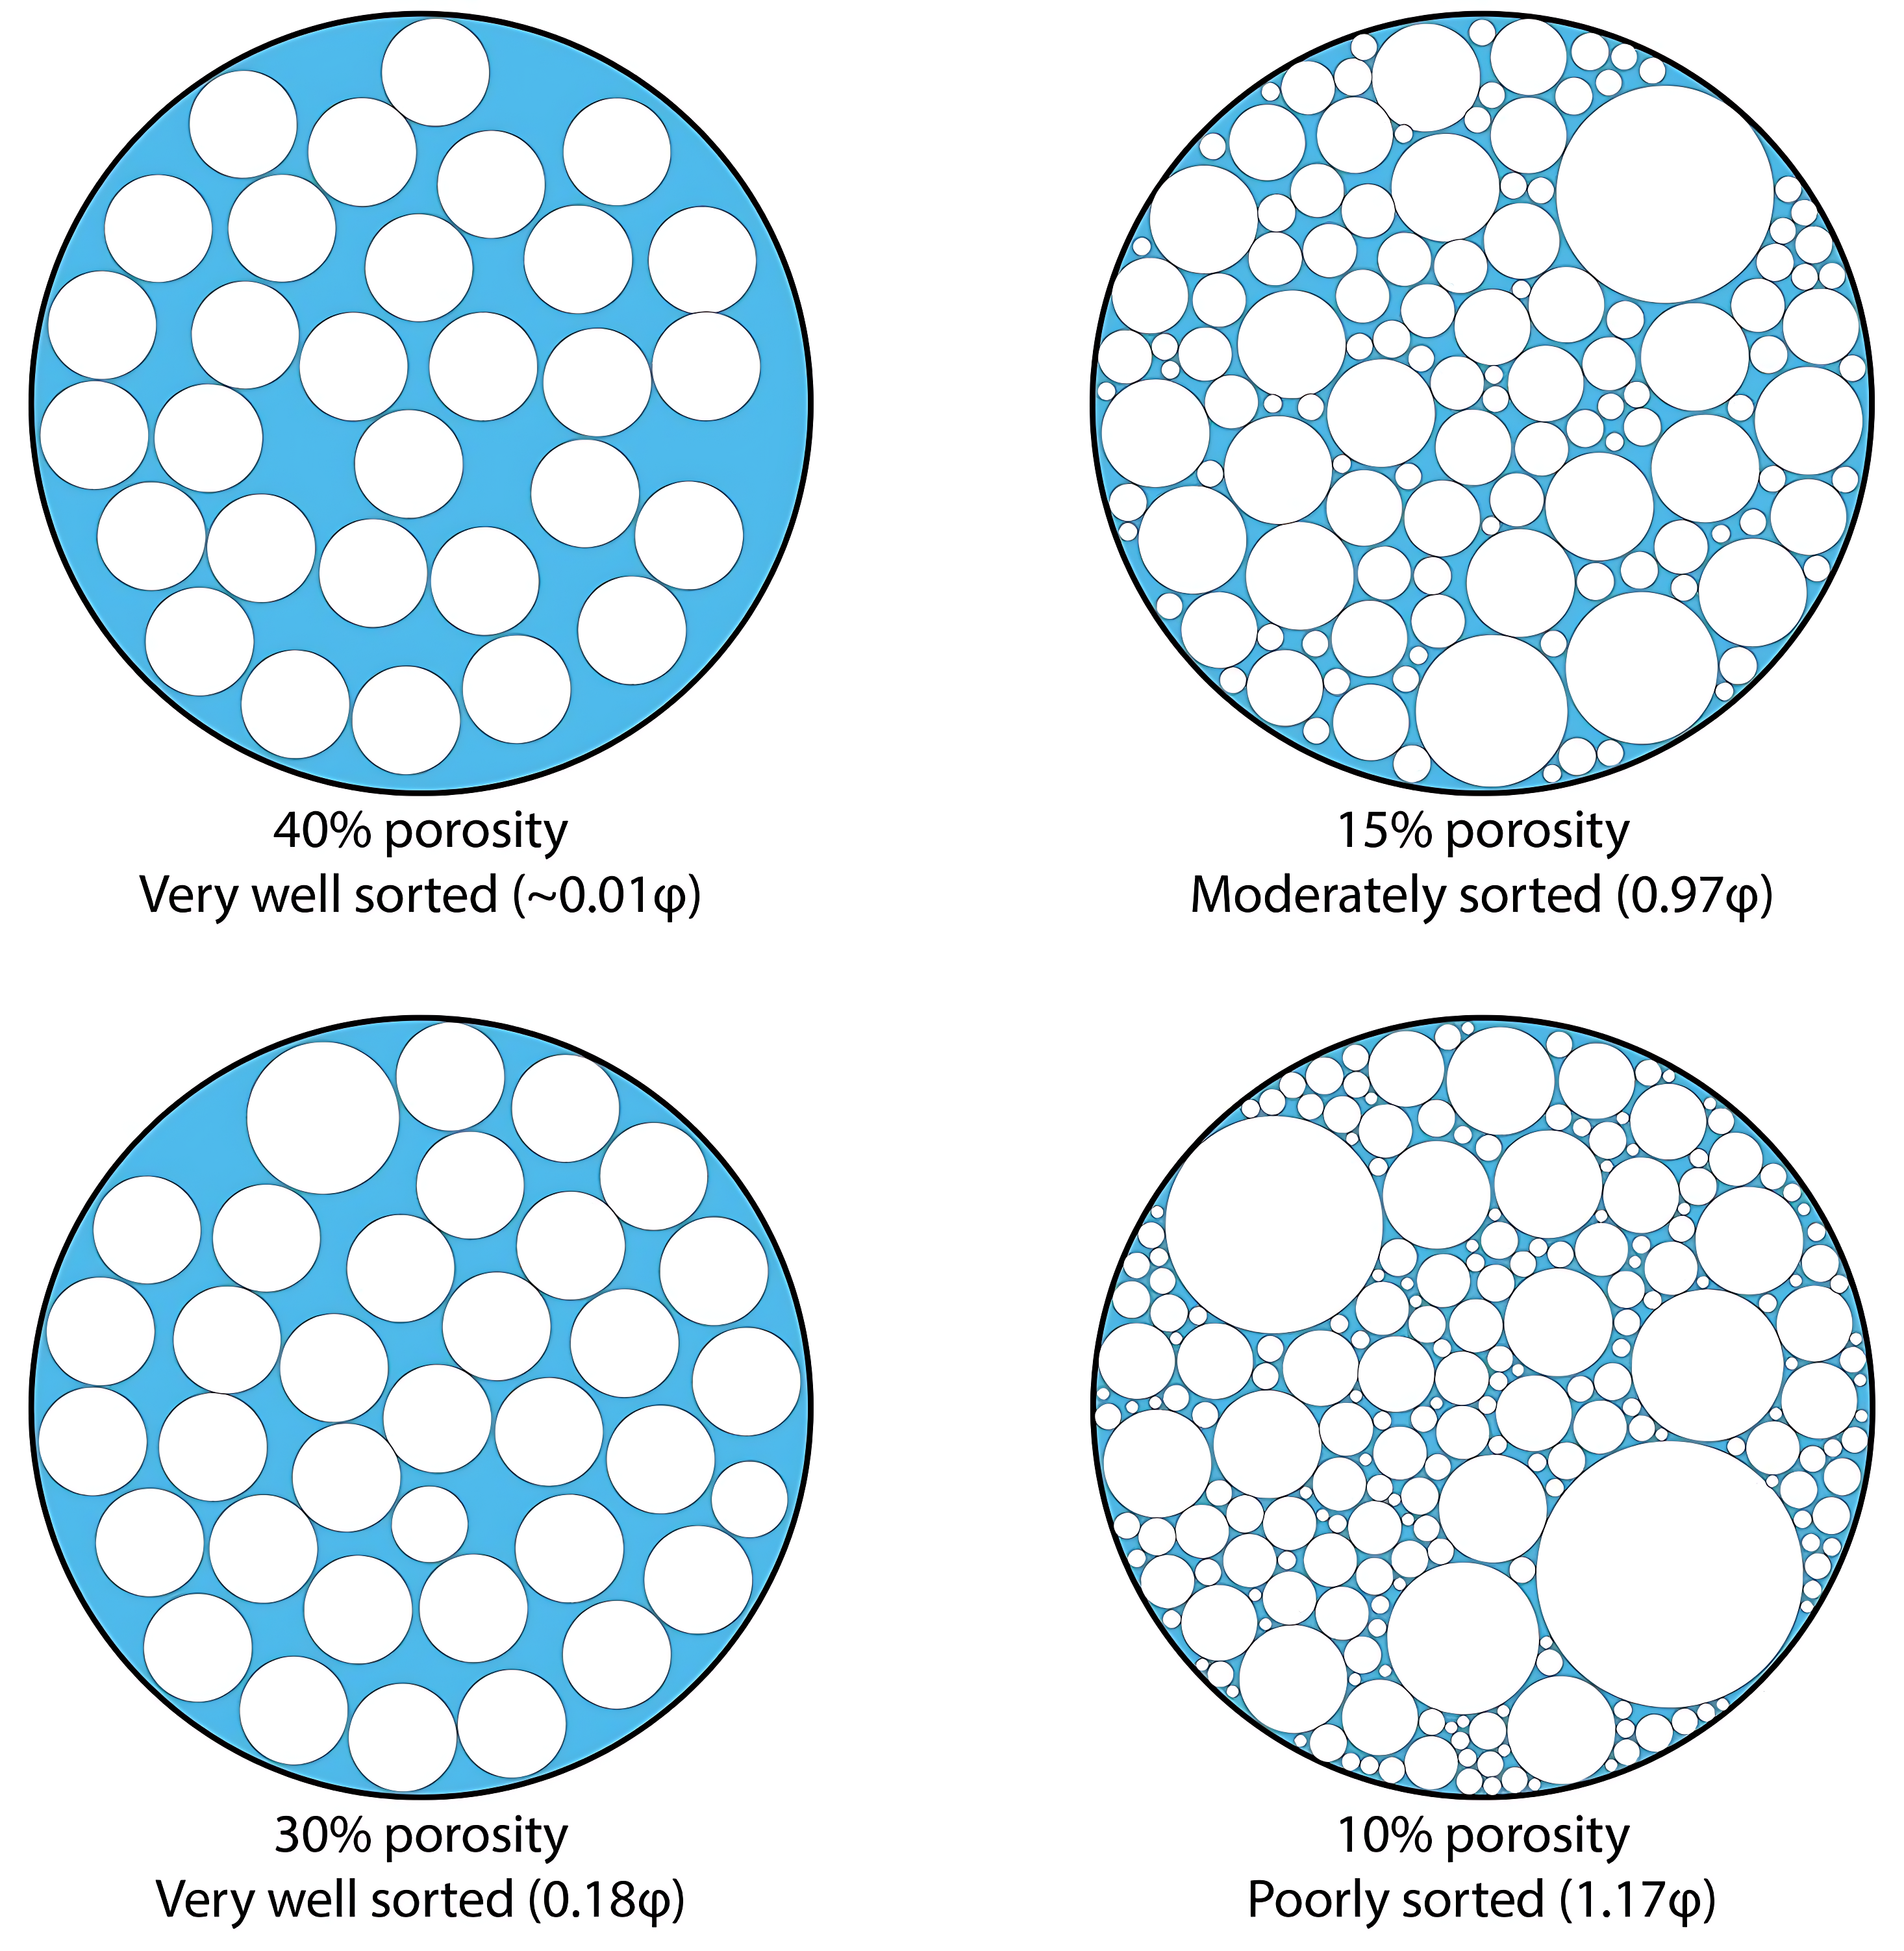
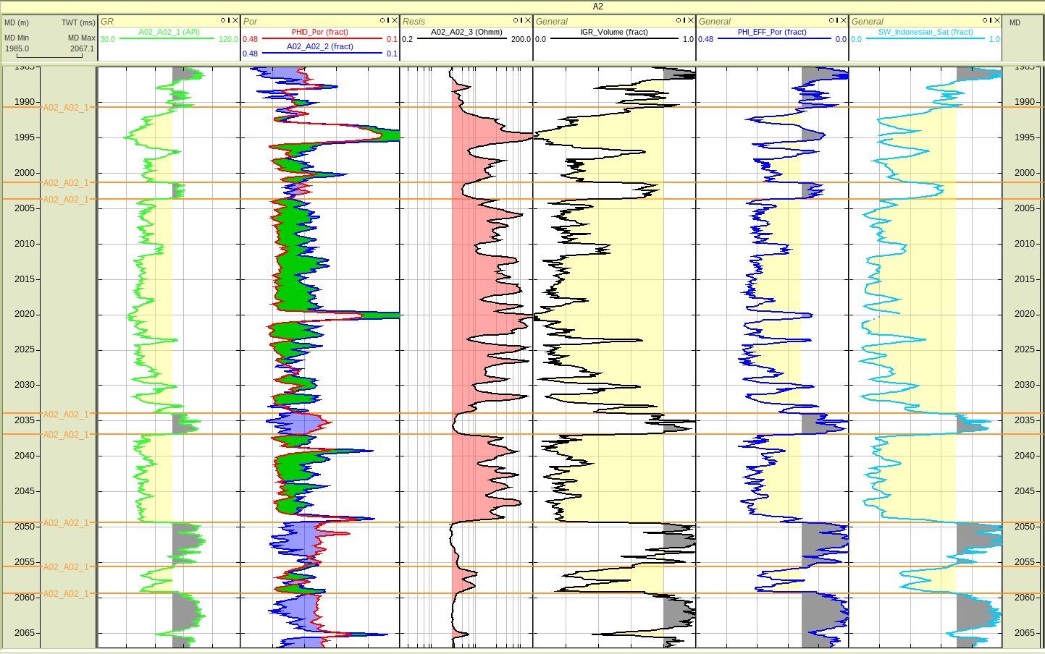
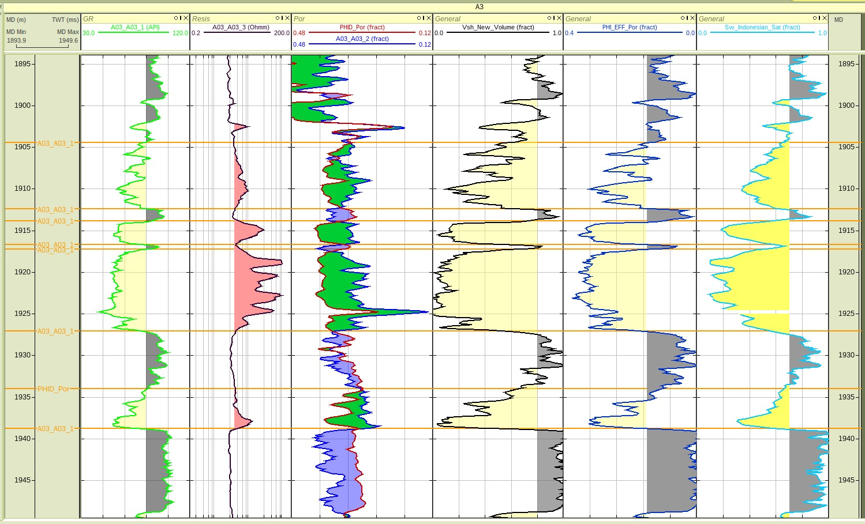
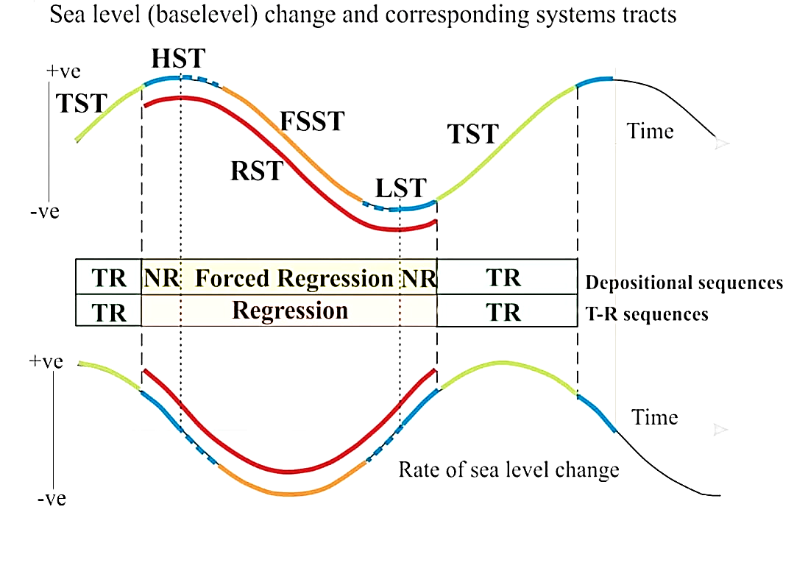
Reservoir Geomorphology and Depositional Environment
SHELF EDGE DEPOSITIONAL ENVIRONMENT DURING LOW STAND SYSTEM TRACK
A1
A2
A3
Well A01 (Toe of Slope Turbidites): The log shows "serrated" or "thin-bedded" signatures, representing the Bouma Sequence. Each spike is a pulse of sand (turbidity current) followed by a return to baseline shale (quiet hemipelagic settling)
Image reference - Contourite porosity, grain size and reservoir characteristics by Xiaohang et.al Sedimentary Geology - Rocks, Environments and Stratigraphy by Michael Rygel and Page Quinton
Well | Depositional Setting | φ–k Relationship | Formation process
A01 | Toe-of-slope turbidites (Bouma sequences) | Significant clustering – similar porosity values produce nearly the same permeability due to very thin lamination and shale barriers | A1 is at the proximal part of turbidite so its location should have coarser grain size than that of A3. Hence better sorting and better clustering in porosity-permeability cross-plot than A3.
A02 | Slope channel / channel-fill sands | Strong positive correlation between porosity and permeability due to well-connected pore networks | High-energy channel flow deposits tend to have thick sands as evinced from the well-log data and also from the porosity-permeability cross-plot.
A03 | Distal lobe fringe (off-axis) | High porosity but low permeability due to clay-filled pores and small pore throats | At the distal lobe fringe part of turbidite, clay content starts to increase, also evident from the well-log data. Therefore, much less clustering in porosity-permeability cross-plot is seen.
Well A02 (Slope Channel): The log shows high-amplitude, "blocky" sand signatures interrupted by shales. This is typical of channel-fill deposits, where high-energy flows leave thick sand packages within the canyon.
Well A03 (Distal Lobe Fringe (Off-Axis) We hereby conclude that A03 sits on the fringe of a laterally offset lobe. What arrives at A03 is only the dilute, fine-grained flow tail — explaining the paradox of worse Bouma development despite being distally positioned.
The reservoir geomorphology of a shelf-edge depositional setting is characterized by high-energy, progradation, and sometimes unstable systems that transfer massive amounts of sediment directly to the deep slope.
These settings, often active during low-stand or falling-stage sea levels, are dominated by shelf-edge deltas and associated gravity-flow deposits
Sea level fall with aggradation dominant shelf edge deltas and submarine lobe complex
The shelf margin was continuously supplying sediment for the generation of turbidity currents in the shelf edge region

Slide 5
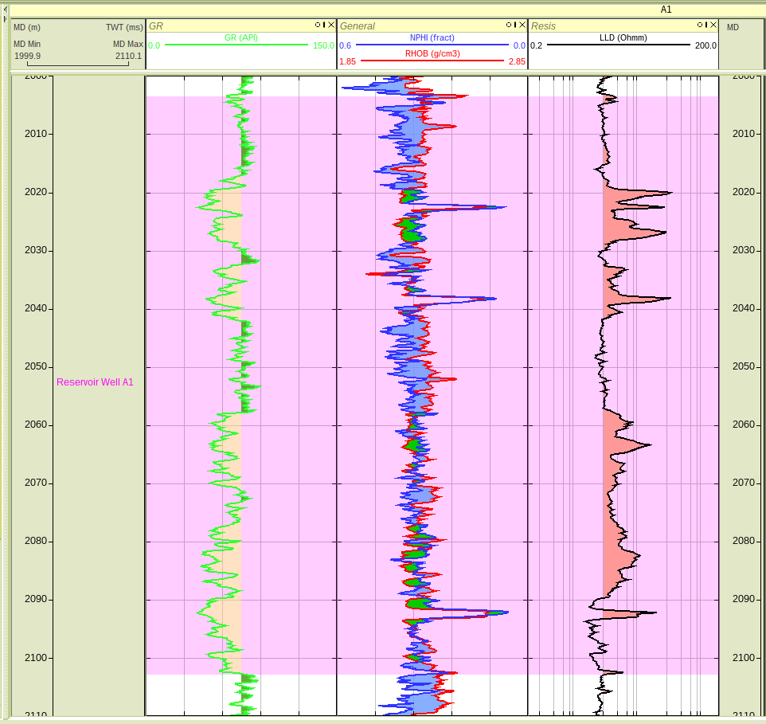
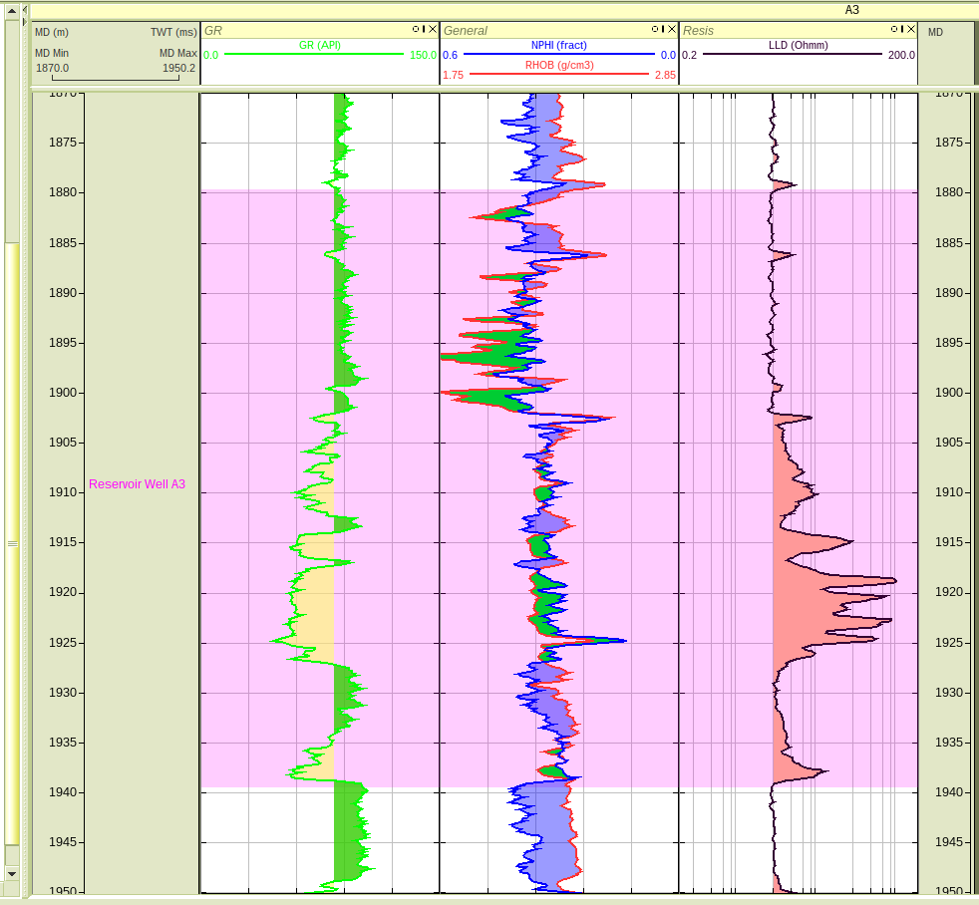
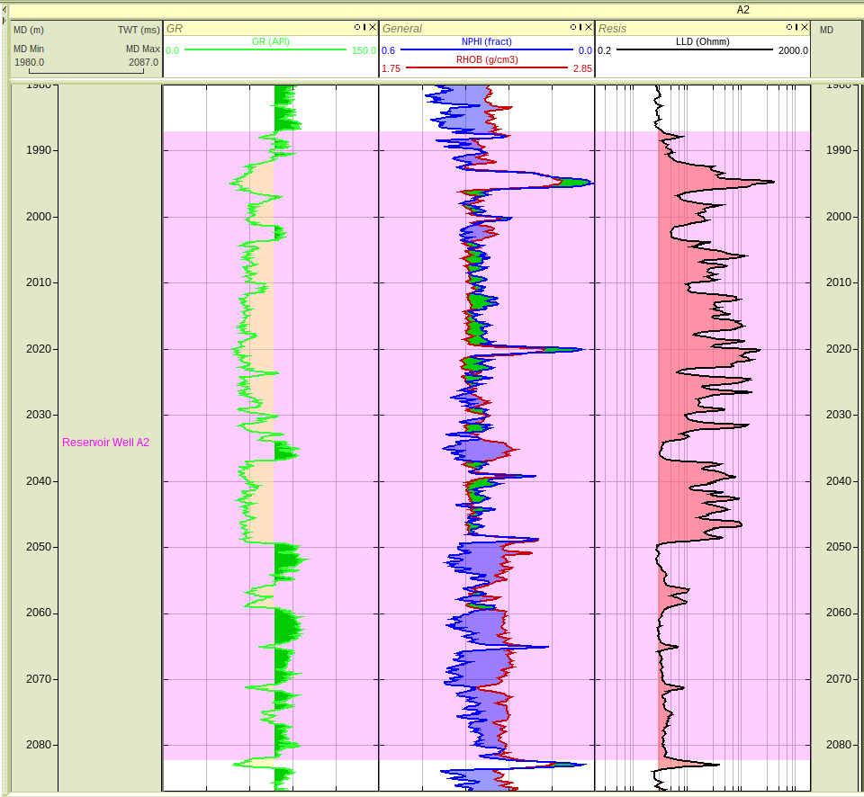
Triple-Combo Log Display: Wells A1, A2, A3
Well A01 (2003.54–2103.01 m)
Low-moderate GR with spikes → sand-shale intercalations
N-D crossover → oil effect or lithology change
Elevated LLD → potential HC zones
Well A03 (1879.67–1939.54 m)
Higher GR than A1 and A2 → shalier reservoir N-D crossover (~1918-1924 m) + high LLD → possible HC zone
Well A02 (1987.21–2082.31 m)
Low-Moderate GR → thick blocky sand
Strong N-D crossover (~2010-2020 m) → probable gas zone
High LLD throughout → excellent HC potential
Fig. 1: Well Log Display for Well A01
Fig. 3: Well Log Display for Well A03
Data Uncertainties:
In well A03, there is a mismatch between the gamma ray log and the crossplot between the neutron and density log. There is a cross over in the region of high Gamma ray log value (high shale).
In A02 (eg.,at 1995m depth), we are getting near zero neutron and log in the region of low API value.
Resistivity scale inconsistency between wells affects inter-well comparison
N-D crossover interpretation limited without independent gas confirmation or fluid samples
Lack of shallow resistivity prevents invasion assessment
Limitations:
Near well A02, the data (maps) is very limited. Since A02, well log analysis gave favorable reservoir values (high NTG value).
Single resistivity curve (LLD only) → invasion profile and true formation resistivity (Rt) cannot be validated
No caliper log available → borehole condition unknown; density and neutron may be affected by washout
Absence of PEF, sonic, NMR or mineralogy logs → lithology interpretation relies solely on GR trends
Environmental corrections (temperature, calliper log mud weight, salinity) not verified → may affect calculated parameters.
Due to intercalated sand and shale layer, it was a challenge to calculate the NTG because of sparse well data
Fig. 2: Well Log Display for Well A02

Slide 6



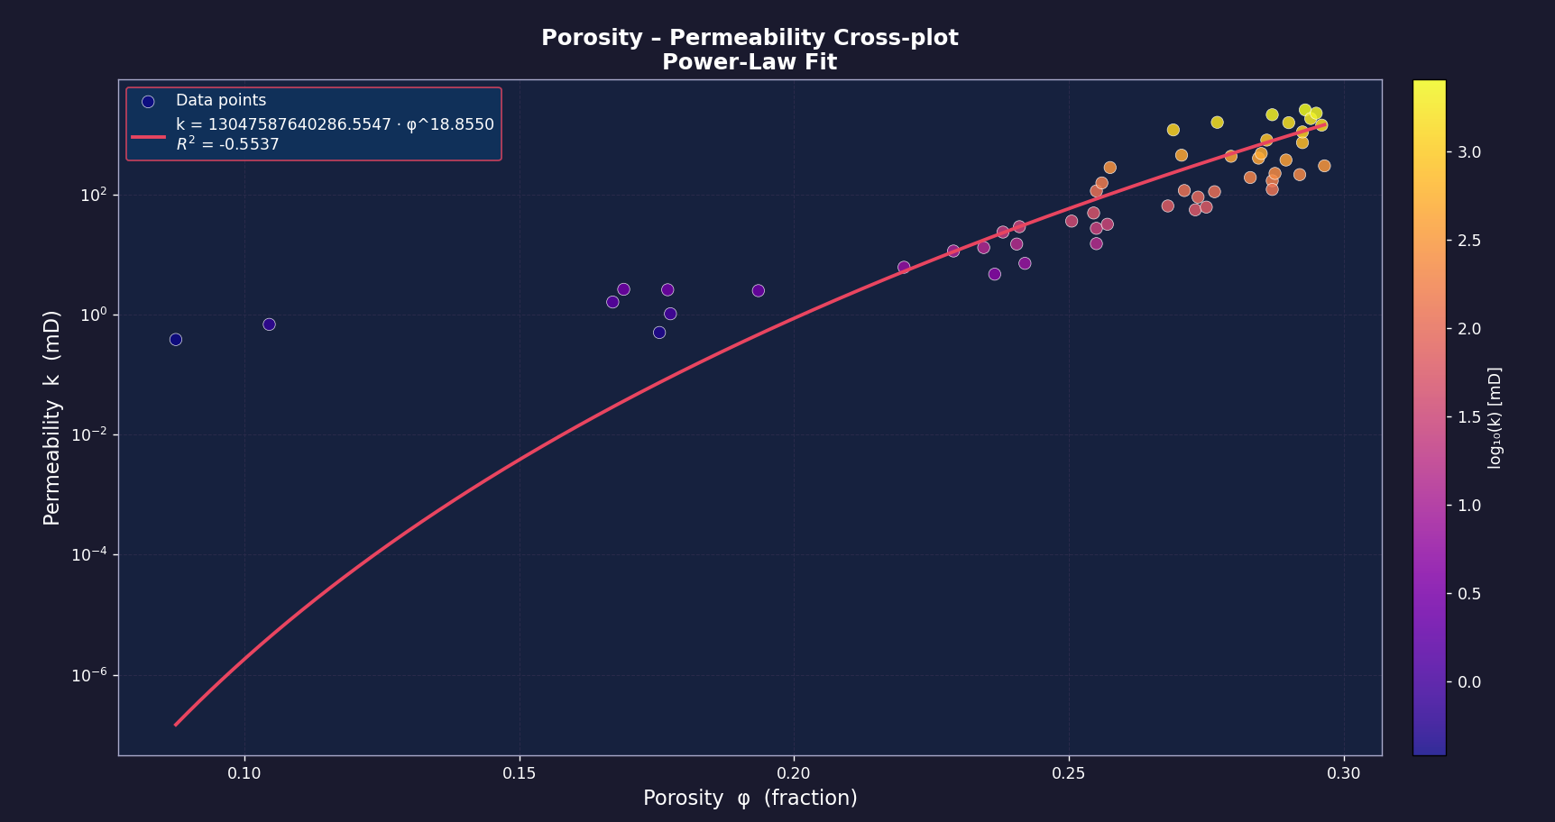

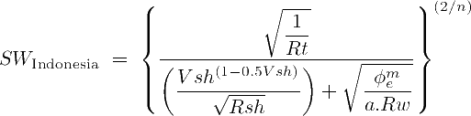

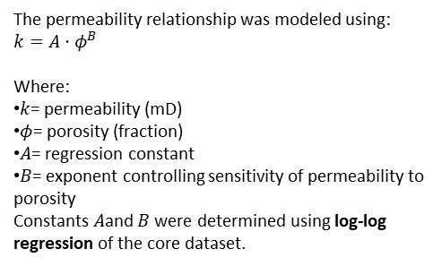
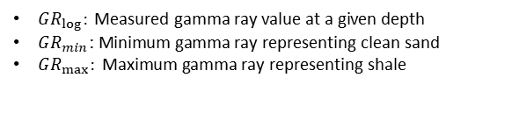



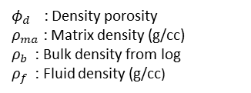


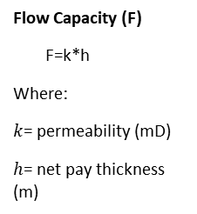
Petrophysical Analysis
Volume of Shale
Indonesian model is used for calculating the water saturation because the study area has intercalated layer of shale and sand. This model gives reasonable range considering the shaly region
$φ$:Combined porosity
$φ_{n}$: Neutron porosity (from neutron log)
$φ_{d}:$ Density porosity (from density log)
Permeability
$GR_{log}: \text{Measured} \text{gamma} \text{ray} \text{value} \text{at} \text{a} \text{given} \text{depth}$
$GR_{min} \text{: }\text{Minimum} \text{gamma} \text{ray} \text{representing} \text{clean} \text{sand}$
$GR_{max}: \text{Maximum} \text{gamma} \text{ray} \text{representing} \text{shale}$
Using the crossplots of porosity vs permeability
The permeability relationship was modeled using:
$$k=A⋅φ^{B}$$
Where:
$k$= permeability (mD)
$φ$= porosity (fraction)
$A$= regression constant
$B$= exponent controlling sensitivity of permeability to porosity
Constants $A$and $B$ were determined using log-log regression of the core dataset.
Vshale was computed using IGR, Stieber, and Larionov methods; however, linear IGR was used for final evaluation because it provides a more conservative estimate where feldspathic/arkosic sands may show elevated GR, especially under the high Vsh cutoff of 80%.
$φⅇ$ : $φ$ : Effective porosity
$$φ_{t} :\text{Total} \text{porosity}$$
$$V_{Sh} :\text{Volume} \text{of} \text{shale}$$
Porosity
NPHI-porosity from neutron log
PHID-porosity from the density log
Water Saturation
Indonesian Model
$φ_{d }$: Density porosity
$ρ_{ma}$ : Matrix density (g/cc)
$ρ_{b}$ : Bulk density from log
$ρ_{f}$ : Fluid density (g/cc)
Reservoir Deliverability Characteristics
Flow Capacity (F)
F=k*h
Where:
$k$= permeability (mD)
$h$= net pay thickness (m)
Reservoir Quality
Index (RQI)
$$RQI=0.0314\sqrt{\frac{k}{φ}}$$
A matrix density greater than 2.65 g/cc was used because the reservoir is not purely quartzose and likely contains feldspathic/arkosic grains and heavy minerals, which increase the effective matrix density.
$$S_{w }$$
: Saturation
: Volume of Shale
: True Resistivity
: cementation factor
: Effective Porosity
: Resistivity of Water
: Tortousity factor
: Resistivity of Shale
$$v_{sh}$$
$$R_{t}$$
$$m$$
$$φ_{e}$$
$$R_{ω}$$
$$a$$
$$R_{sh}$$

Slide 7
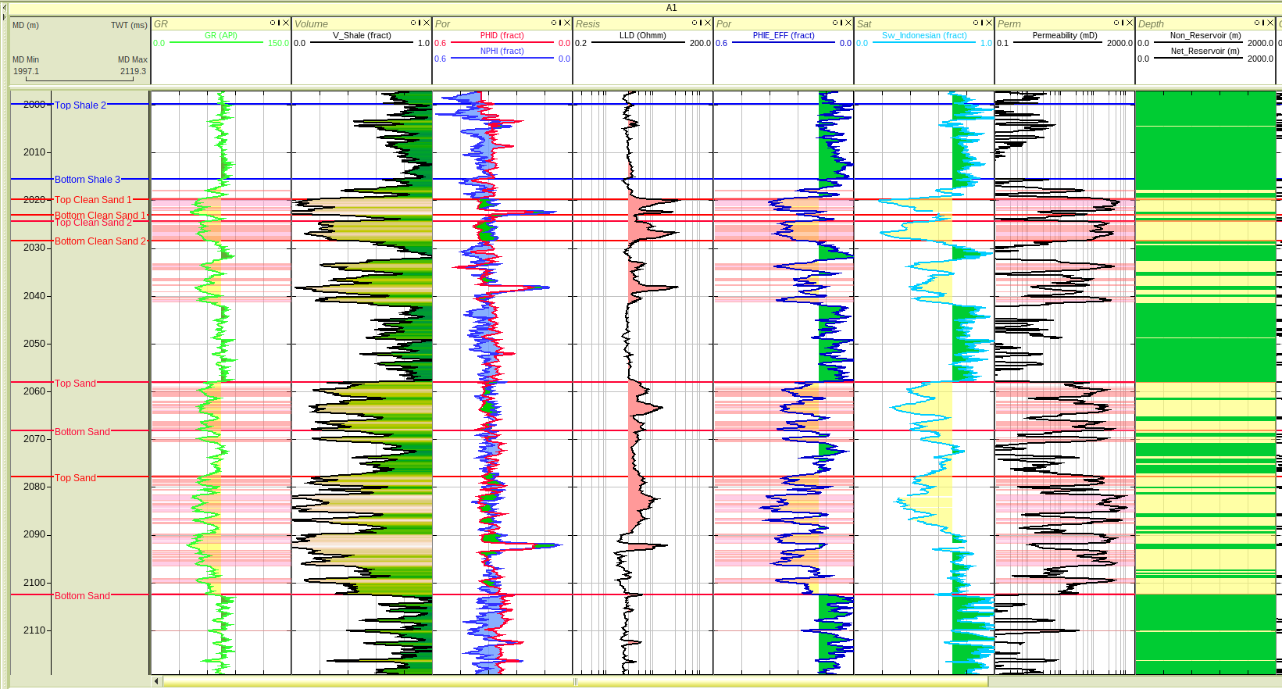
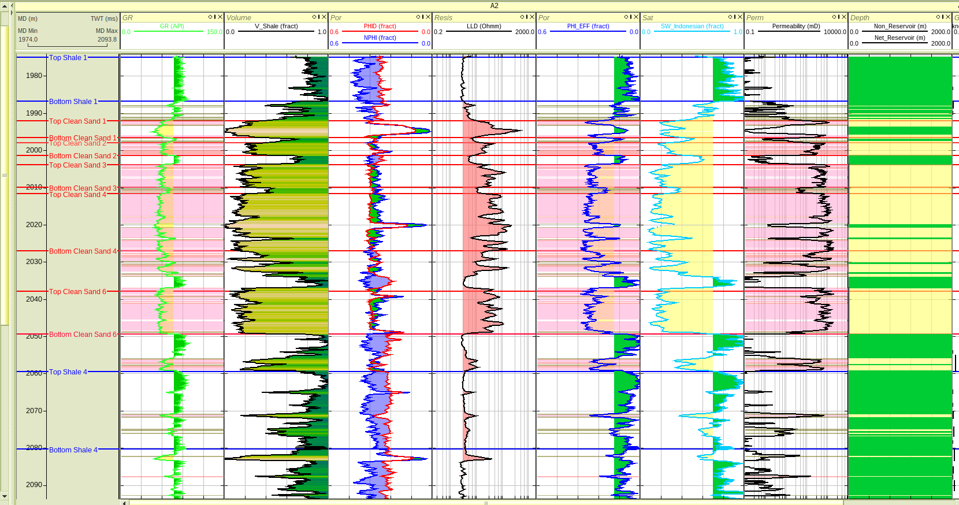
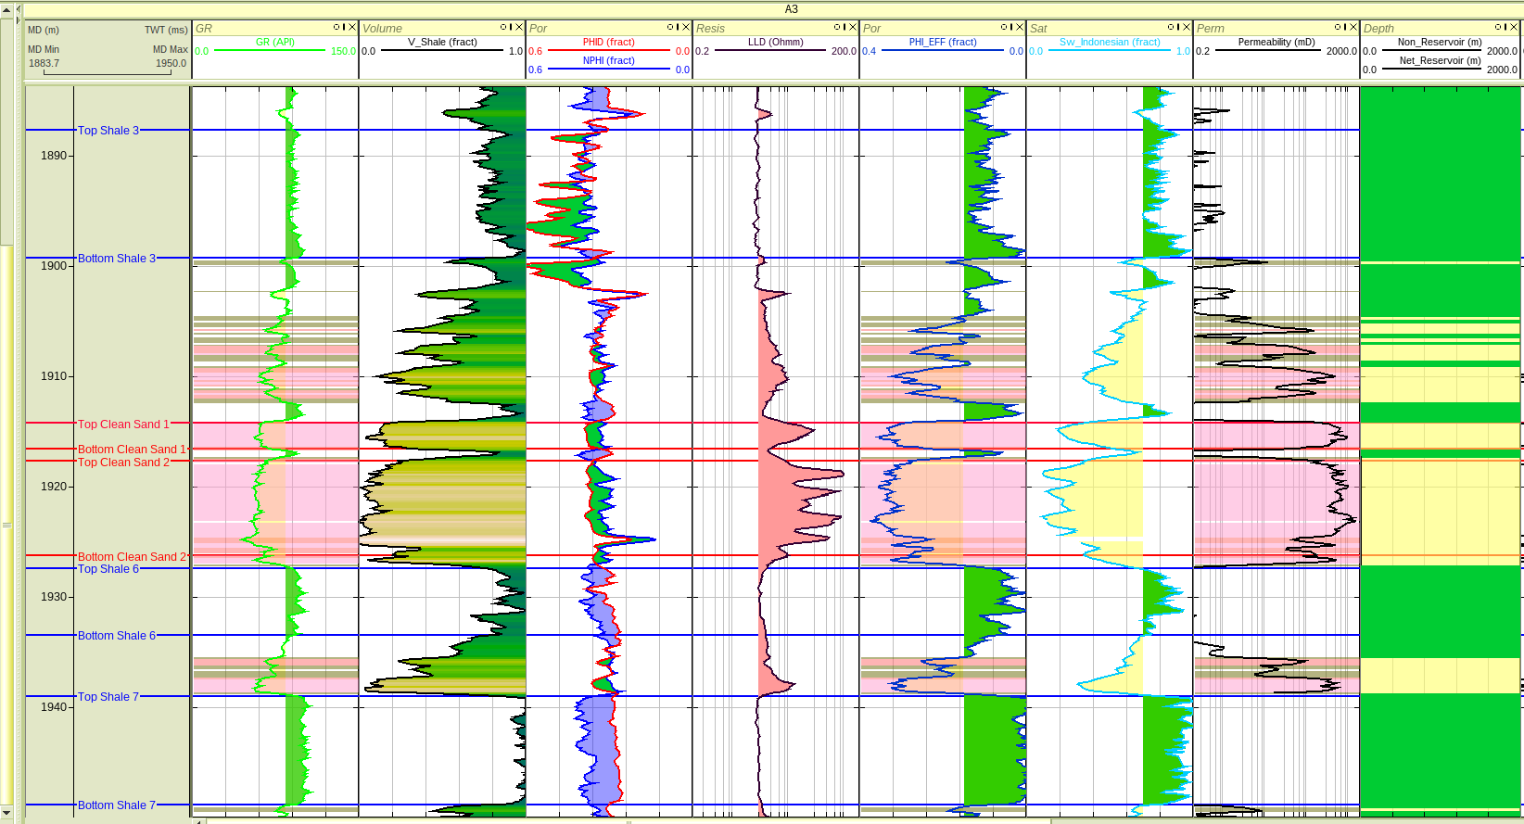
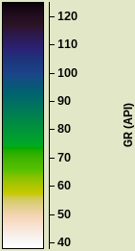
Quantitative Petrophysical Analysis and Interpretation
Well A01
Well A02
Vsh @ 0.80
Well A03
Clean Sand
Shaly Sand
Shale
Rock Type 1
OWC @ 70% Sw
In the reservoir interval, there is a sudden increase in Sw and decrease in Rt.
Non Reservoir
GR (API)
Rock Type 2
Reservoir
In similar manner, interpretations are done for all the wells and the values are added in the summary table

Slide 8
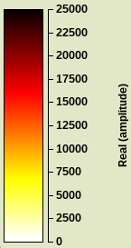
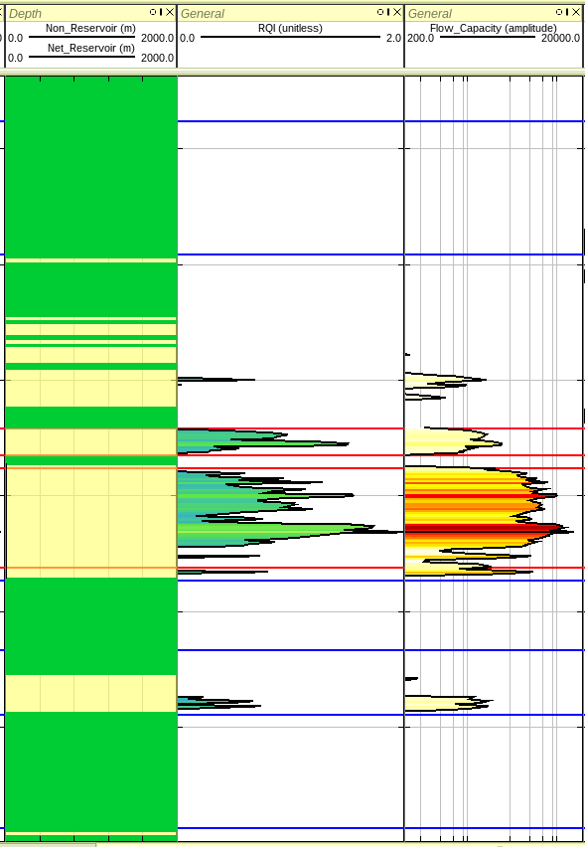
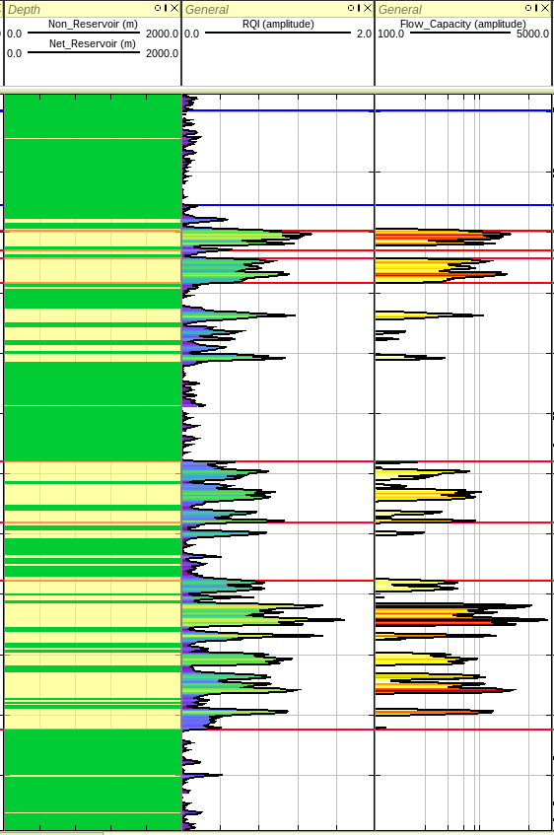
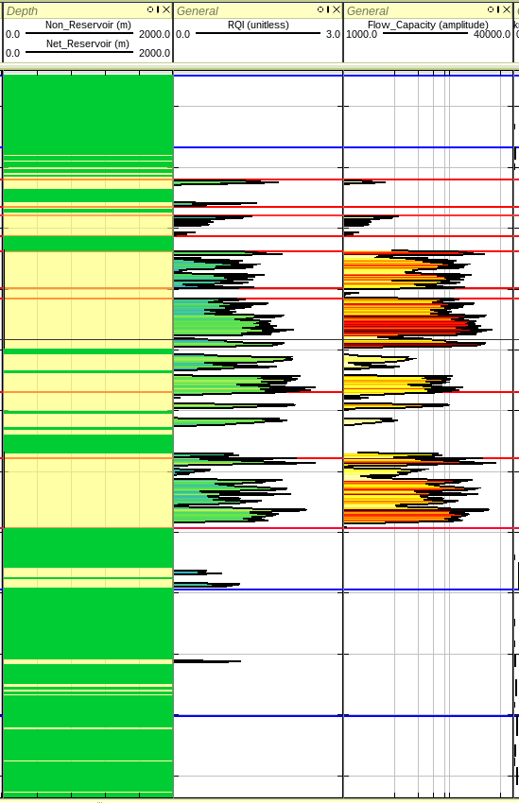
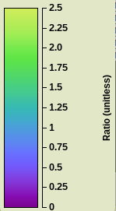

Reservoir Deliverability Characteristics and Petrophysical Properties Summary
Deliverability is fundamentally controlled by:
$$q∝\frac{kh}{μ}ΔP$$
Petrophysical Properties Summary
Petrophysical Property | A01 | A02 | A03
Gross thickness (m) | 99.47 | 95.10 | 59.87
Net Reservoir (m) | 47.39 | 53.03 | 22.25
Net pay (m) | 36.27 | 52.27 | 21.03
Net-to-Gross (%) | 36.46 | 54.96 | 35.12
Avg Vsh | 0.50 | 0.44 | 0.55
Avg Φeff | 0.17 | 0.18 | 0.15
Avg Sw | 0.64 | 0.45 | 0.61
Avg Permeability (mD) | 77.34 | 330.09 | 123.95
Flow Capacity (kh) | 455.02 | 5554.49 | 2267.58
Rock Quality Index (RQI) | 0.35 | 0.75 | 0.35
Deliverability Ranking | 3 | 1 | 2
Flow Capacity
Rock Quality Index
Parameter | Well A03 | Well A01 | Well A02
Reservoir Quality (RQI) | High, concentrated in main interval | Moderate to high in several intervals | Moderate, distributed
Flow Capacity (kh) | Strong peak in central sand | Multiple moderate peaks | Moderate peaks
Reservoir Architecture | Thick continuous sand | Stacked sands | Thin stacked sands
Vertical Heterogeneity | Moderate | Moderate-high | High
Deliverability | High | Moderate-High | Moderate

Slide 9
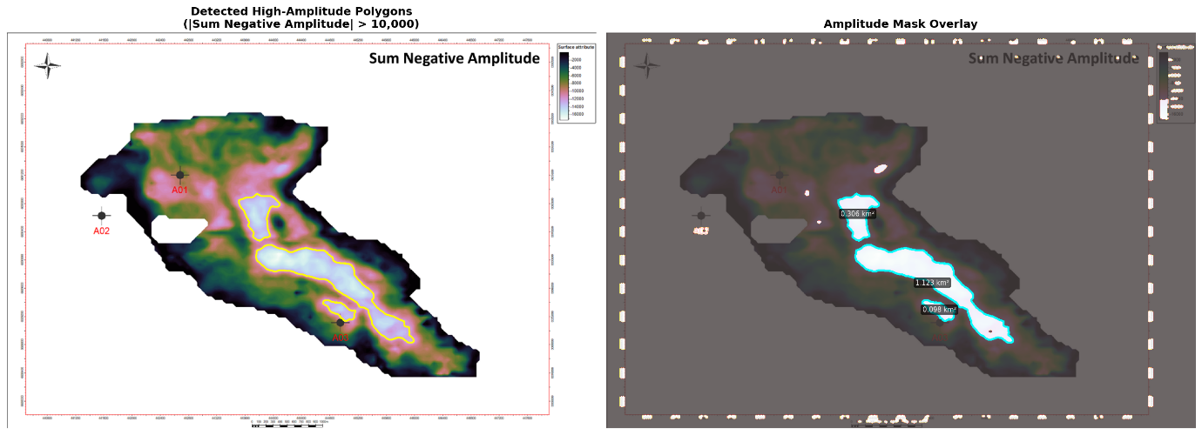
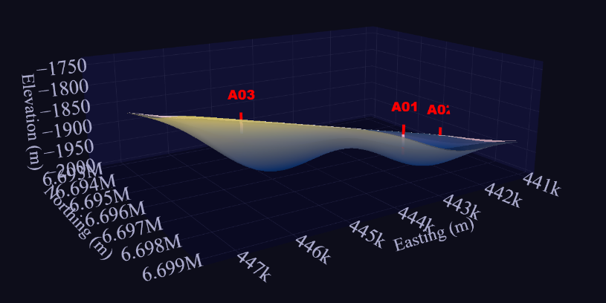
Net-to-Gross Analysis
Gross Reservoir Thickness
Net to Gross Estimation
Appraisal Well
For vertical wells, gross reservoir thickness is calculated as the difference between reservoir bottom and top depths.
Ratio of net reservoir thickness to gross thickness, indicating the proportion of reservoir-quality rock
N/G (%) = (Net Pay thickness / Gross thickness) × 100
The selected location is proposed for drilling the next appraisal well to evaluate the size, quality, and commercial potential of the hydrocarbon accumulation.
The point lies within a channel-levee depositional system and in the upthrown block, providing a favorable trapping location.
Faults in the region may act as the potential migration pathways, allowing hydrocarbons to move from the source rock to the reservoir (away from proximal part).
The SNA attribute map shows a bright spot anomaly, and the point lies near its boundary, helping to determine the lateral extent of the reservoir.
Therefore, the appraisal well is recommended near 444000E, 6690000N.
Gross Thickness = Bottom depth - Top depth
Reservoir Thickness Summary
Where,
Bottom = Base of reservoir interval (m)
Top = Top of reservoir interval (m)
Well | Gross Thickness (m) | Net Reservoir (m) | Net Pay (m) | N/G (%)
A01 | 99.47 | 47.39 | 36.27 | 36.46
A02 | 95.10 | 53.03 | 52.27 | 54.96
A03 | 59.87 | 22.25 | 21.03 | 35.12
Well A01: H1 = 2103.01 - 2003.54 = 99.47 m
Well A02: H2 = 2082.31 - 1987.21 = 95.10 m
Well A03: H3 = 1939.54 - 1879.67 = 59.87 m
Net Reservoir Thickness
Further development recommendation
Net reservoir is calculated by applying petrophysical cutoffs to identify reservoir-quality intervals.
Well A02 shows the most favorable NTG value and petrophysical properties from well log analysis.
Geological studies and well log correlations indicate a fault between Wells A02 and A01.
Therefore, an exploratory well is recommended near A02.
Petrophysical cutoffs: V_shale ≤ 80%, φ ≥ 15%
Methodology:
Thickness log generated in RokDoc using V_shale ≤ 80% and φ ≥ 15% cutoffs
Intervals meeting both criteria flagged as net reservoir
Exported to Excel and summed for each well's reservoir zone
However, limited data in this region restricts further detailed interpretation.
4448000E, 6690000N
Net Pay Thickness
Net pay calculated using additional water saturation cutoff: V_shale ≤ 80%, φ ≥ 15%, Sw ≤ 70%
Method: Same as net reservoir with additional Sw ≤ 70% filtering applied.

Slide 10
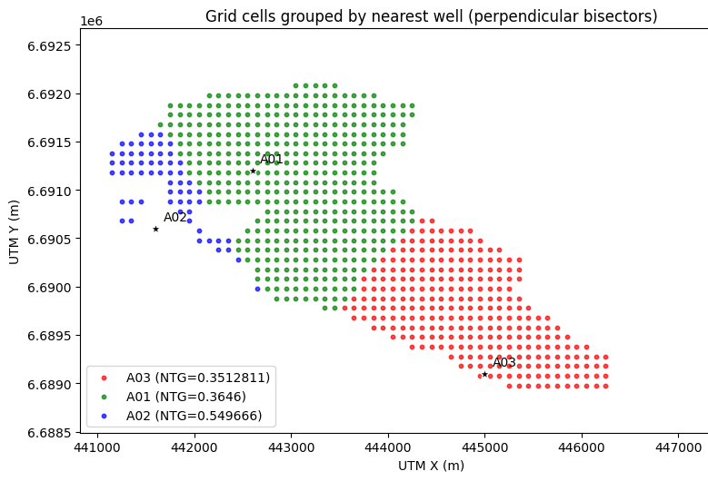
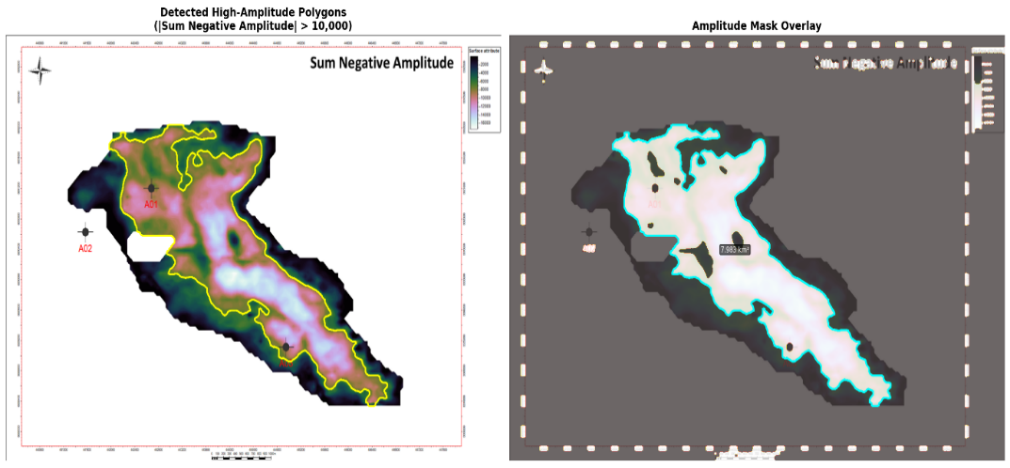
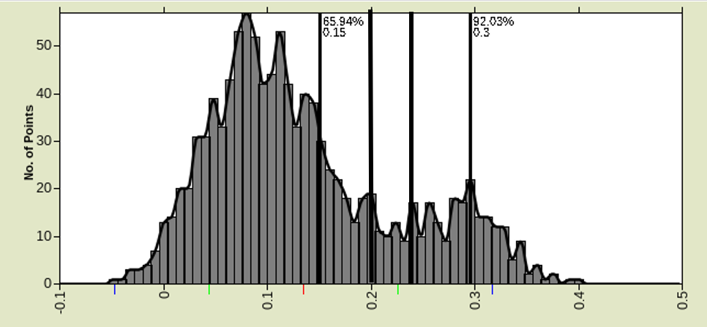
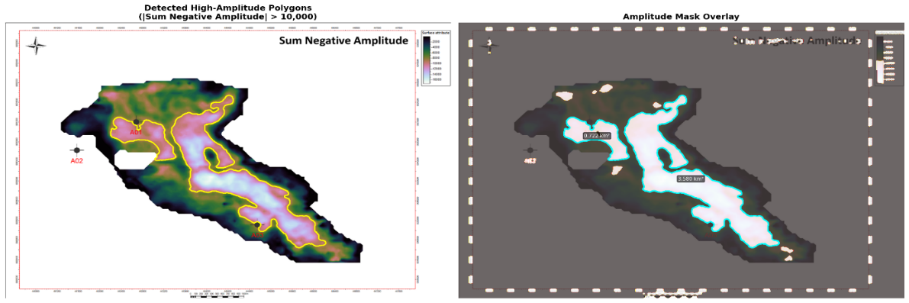


STOIIP Calculation I
STOIIP(MMBO):-
(Bulk Rock Volume*7758*$Φ$*(1-$s_{w}$)*1/$B_{0})$*1/${10}^{6}$
2. Average net pay thickness:-
Bulk Rock Volume (acre feet) = A * h , A = Drainage area (acres), h = Net pay thickness (feet), 7,758 = API Bbl per acre-feet
= Porosity, Sw = water saturation, Bo =1.3 Formation volume factor (Reservoir Bbl/STB) 1/Bo = Shrinkage (STB/reservoir Bbl)
Channel thickness values are digitized and extracted from the given channel thickness map by dividing it into 100X100m grids.
We have used Voronoi partition by connecting the wells. We have 3 groups of channel thickness data, this is multiplied with the net to gross ratio of the respective wells. Mean of these net pay thickness is taken for h= 29ft (8.9m)
We have calculated 3 STOIIP values in order to give a probabilistic estimation- min, most likely and max. Methods used for calculating the parameters are explained below
1.Area
3. Petrophysical parameters:-
1.1.Max:-
For this case we have taken the polygons which encloses the amplitude>6000
For porosity and saturation values, we have taken 3 values for min, max and most likely values for each wells A01, A02 and A03 from their histograms.
By using the Voronoi partition we have the count of the points belonging to each group and its respective wells.
Using this as the weights for the values we have calculated the weighted average for each models (min, max, most likely)
Porosity histogram plots
A01
Area=7.983sq.Km
1.2.Most likely:-
these polygons encloses the amplitude>10000.
1.3.Min:-
For this case we have taken the polygons which encloses the amplitude>16000
Area=0.722+3.580 sq. Km.= 4.302 sq.Km.
Area=0.306+1.123+0.098 sq. Km=1.527 sq.Km

Slide 11
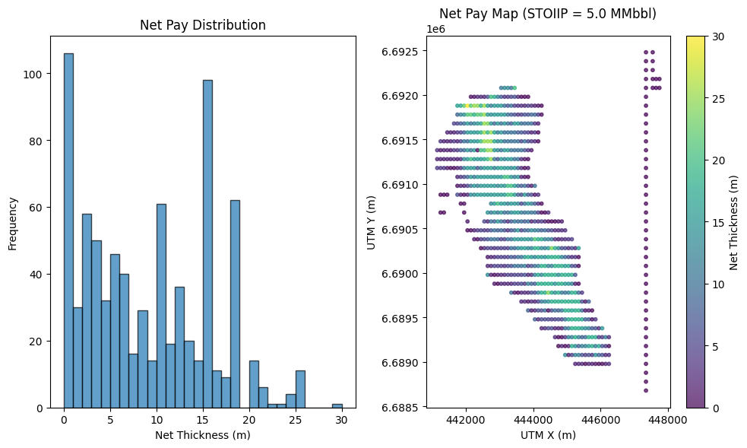
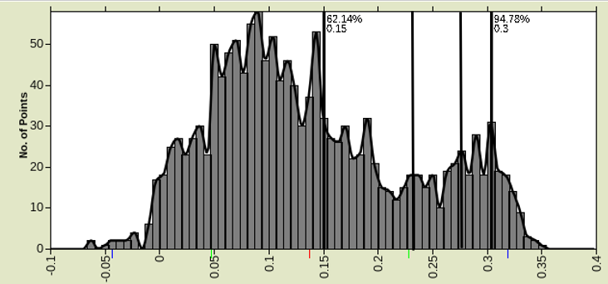
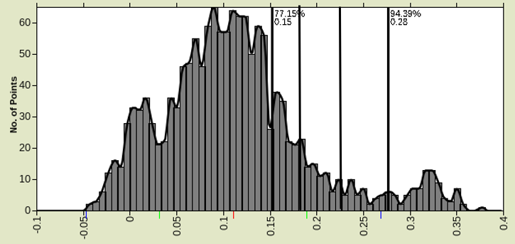
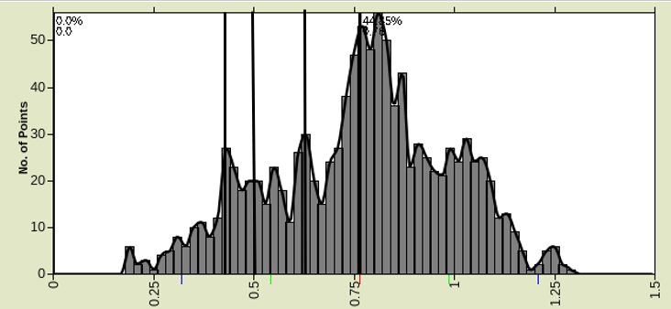
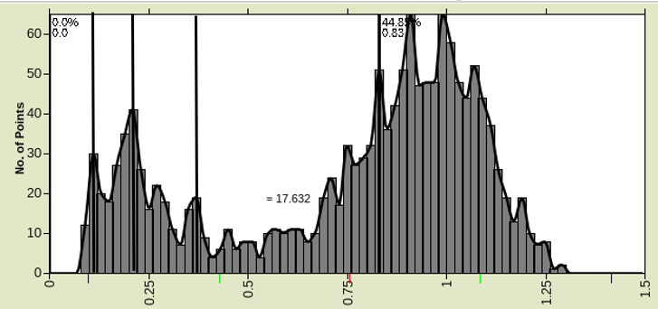
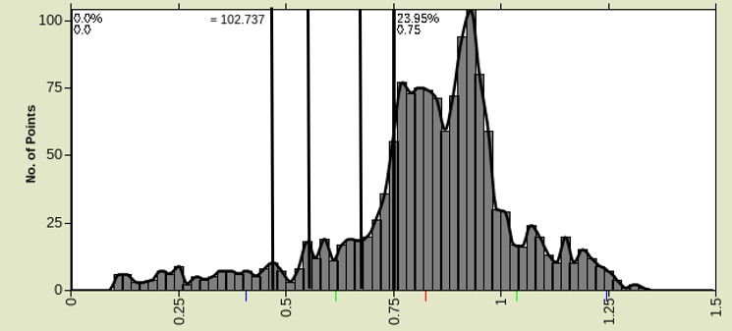
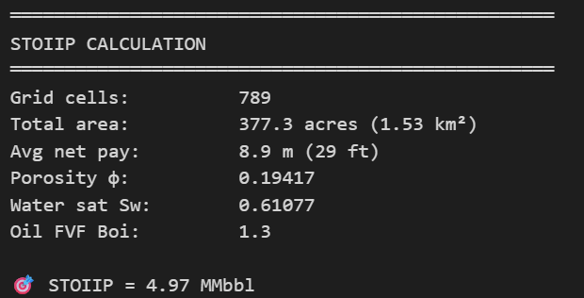
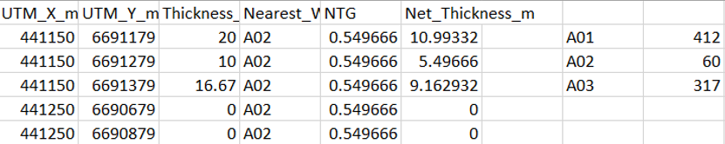
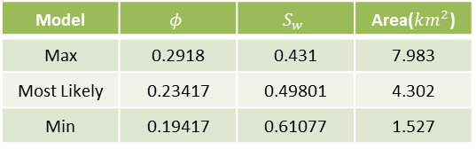
STOIIP Calculation II
3. Petrophysical parameters:-
Porosity
A02
Porosity
A03
Model | A01 | A02 | A03
Max | 0.3 | 0.3 | 0.28
Most Likely | 0.24 | 0.27 | 0.22
Min | 0.2 | 0.23 | 0.18
Saturation
Saturation
A01
A02
Model | A01 | A02 | A03
Max | 0.45 | 0.11 | 0.47
Most Likely | 0.5 | 0.21 | 0.55
Min | 0.6 | 0.37 | 0.67
Model | STOIIP (MMBO)
Max | 57.06
Most Likely | 21.8
Min | 4.97
A03
Weighted mean:-(W1*P1+W2*P2+W3*P3)/(W1+W2+W3)
Where P-petrophysical properties
4. Final STOIIP values:-
Weights for each well
Model | $$φ$$ | $$S_{w}$$ | Area($km^{2}$)
Max | 0.2918 | 0.431 | 7.983
Most Likely | 0.23417 | 0.49801 | 4.302
Min | 0.19417 | 0.61077 | 1.527

